Slide 1
Types of Pattern
Patterns are of various types, each satisfying certain casting requirements.
1. Single piece pattern
2. Split or two piece pattern
3. Match plate pattern

Slide 2
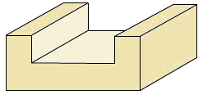
Single Piece Pattern
The one piece or single pattern is the most inexpensive of all types of patterns. This type of pattern is used only in cases where the job is very simple and does not create any withdrawal problems. It is also used for application in very small-scale production or in prototype development. This type of pattern is expected to be entirely in the drag and one of the surface is expected to be flat which is used as the parting plane. A gating system is made in the mold by cutting sand with the help of sand tools. If no such flat surface exists, the molding becomes complicated. A typical one-piece pattern is shown

Slide 3
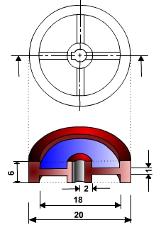
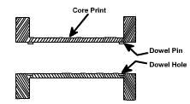
Split or Two Piece Pattern
Split or two piece pattern is most widely used type of pattern for intricate castings. It is split along the parting surface, the position of which is determined by the shape of the casting. One half of the pattern is molded in drag and the other half in cope. The two halves of the pattern must be aligned properly by making use of the dowel pins, which are fitted, to the cope half of the pattern. These dowel pins match with the precisely made holes in the drag half of the pattern. A typical split pattern of a cast iron wheel

Slide 4
Molding Material and Properties
A large variety of molding materials is used in foundries for manufacturing molds and cores. They include
molding sand
system sand or backing sand
facing sand
parting sand
core sand.
The choice of molding materials is based on their processing properties

Slide 5
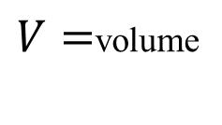

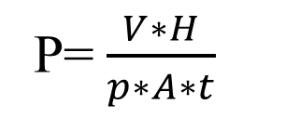
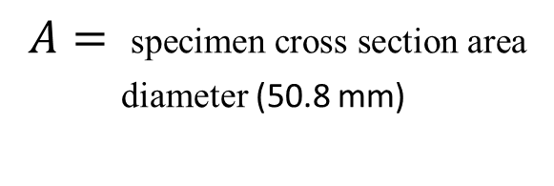

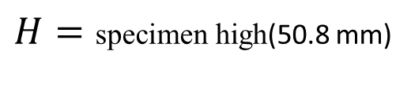
Refractoriness
It is the ability of the molding material to resist the temperature of the liquid metal to be poured so that it does not get fused with the metal. The refractoriness of the silica sand is highest.
Permeability
During pouring and subsequent solidification of a casting, a large amount of gases and steam is generated. These gases are those that have been absorbed by the metal during melting, air absorbed from the atmosphere and the steam generated by the molding and core sand. If these gases are not allowed to escape from the mold, they would be entrapped inside the casting and cause casting defects. To overcome this problem the molding material must be porous. Proper venting of the mold also helps in escaping the gases that are generated inside the mold cavity
$V=$volume
$t$ =time
P=$\frac{V∗H}{p∗A∗t}$
$H=\text{specimen} \text{high}$(50.8 mm)
permeability number
$$p=\text{pressure}$$
$$A= \text{specimen} \text{cross} \text{section} \text{area}$$
diameter (50.8 mm)

Slide 6
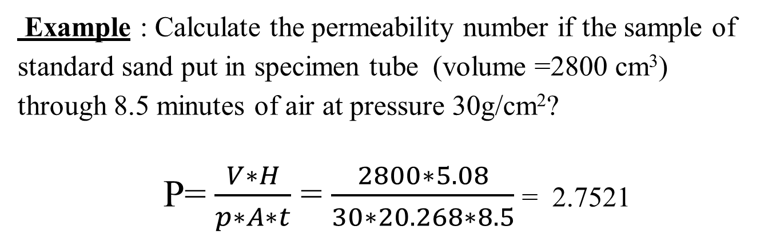
Example : Calculate the permeability number if the sample of standard sand put in specimen tube (volume =2800 cm³) through 8.5 minutes of air at pressure 30g/cm²?
P=$\frac{V∗H}{p∗A∗t}$ = $\frac{2800∗5.08}{30∗20.268∗8.5}$ = 2.7521

Slide 7
Green Strength
The molding sand that contains moisture is termed as green sand. The green sand particles must have the ability to cling to each other to impart sufficient strength to the mold. The green sand must have enough strength so that the constructed mold retains its shape.
Dry Strength
When the molten metal is poured in the mold, the sand around the mold cavity is quickly converted into dry sand as the moisture in the sand evaporates due to the heat of the molten metal. At this stage the molding sand must posses the sufficient strength to retain the exact shape of the mold cavity and at the same time it must be able to withstand the metallostatic pressure of the liquid material.

Slide 8
Hot Strength
As soon as the moisture is eliminated, the sand would reach at a high temperature when the metal in the mold is still in liquid state. The strength of the sand that is required to hold the shape of the cavity is called hot strength.
Collapsibility
The molding sand should also have collapsibility so that during the contraction of the solidified casting it does not provide any resistance, which may result in cracks in the castings. Besides these specific properties the molding material should be cheap, reusable and should have good thermal conductivity

Slide 9
Molding Sand Composition
The main ingredients of any molding sand are:
Base sand,
Binder,
Moisture
Base Sand
Silica sand is most commonly used base sand. Other base sands that are also used for making mold are zircon sand, Chromate sand, and olivine sand. Silica sand is cheapest among all types of base sand and it is easily available.

Slide 10
Binder
Binders are of many types such as:
Clay binders,
Organic binders and
Inorganic binders
Clay binders are most commonly used binding agents mixed with the molding sands to provide the strength. The most popular clay types are:
1-Kaolinite or fire clay (Al₂O₃ 2 SiO₂ 2 H₂O) and
2- Bentonite (Al₂O₃ 4 SiO₂ nH₂O)
Of the two the Bentonite can absorb more water which increases its bonding power.

Slide 11
Moisture
Clay acquires its bonding action only in the presence of the required amount of moisture. When water is added to clay, it penetrates the mixture and forms a microfilm, which coats the surface of each flake of the clay. The amount of water used should be properly controlled. This is because a part of the water, which coats the surface of the clay flakes, helps in bonding, while the remainder helps in improving the plasticity. A typical composition of molding sand is given in (Table)
Molding Sand Constituent | Weight Percent
Silica sand | 92
Clay (Sodium Bentonite) | 8
Water | 4

